Slide 1


INVENTRA-INTELLIGENT INVENTORY MANAGEMENT SYSTEM
Presentedby : TEAM 1
Rishwana Sirajutheen
Naga Syamala Chintapalli
Dritisai Sivarathri
Tanoor Kiran
Hemanth Ravva

Slide 2

Meaning of “Inventra”
•Inventra = Inventory + Automation
•The system aims to manage inventory intelligently by tracking stock, sales, purchases, suppliers, and products.
•It reduces manual work, avoids stock-out/overstock issues, and ensures efficient inventory control.
•The title reflects the system’s goal:
“An intelligent platform to automate and optimize inventory operations.”

Slide 3
Existing System
Problems in the Existing System
•Inventory is maintained manually using Excel or paper.
•High chances of human error in stock entry.
•No automatic stock updates after sales or purchase.
•Difficult to identify low-stock items.
•No real-time tracking.
•Reports are produced manually, which is time-consuming.
•Lack of system security and authentication.

Slide 4
PROPOSED SOLUTION: INVENTRA
Inventra is a smart inventory platform that:
A fully automated inventory management application.
Tracks products, suppliers, stock levels, purchase and sales in real-time.
Provides alerts, reports, and secure authentication.
Simple user interface with accurate data processing.
Goal:Move from reactive inventory → intelligent inventory

Slide 5
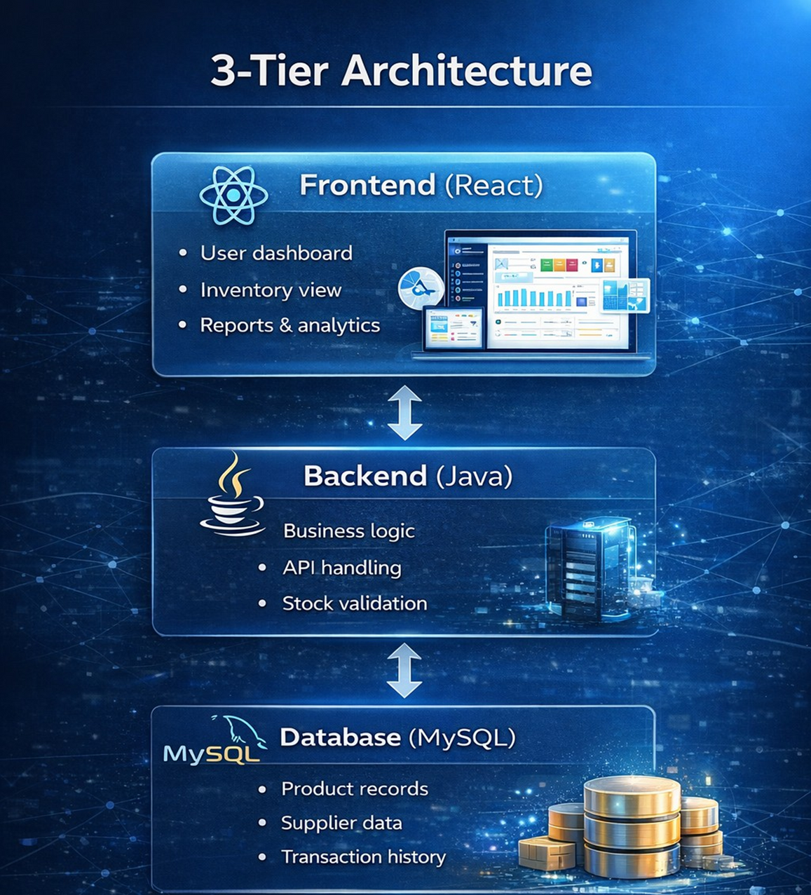
SYSTEM ARCHITECTURE

Slide 6
MODULES
•Authentication - Login, token generation, role validation
•Product / Inventory Management - Add, update, remove items, manage stock levels
•Inventory Alerts - Low stock, expiry alerts, fast/slow moving items
•Reports & Analytics - Charts, predictions, insights

Slide 7
SYSTEM CONFIGURATION
Hardware Requirements
•Processor: Intel i5 or above
•RAM: 8GB or more
Software Requirements :
•Operating System :Windows
•Programming Language: Java
•Front end: React.js
•Database : MySQL + MySQL workbench
•Tools: Eclipse/IntelliJ
•Back end : Spring Boot ,spring MVC, REST API

Slide 8
MODULE 1: AUTHENTICATION
•Entry point of the Inventory Management System
•Verifies user identity using username and password
•Allows only authorized users to access the system
•Provides role-based access (Admin, Manager, Staff)
•Restricts users to permitted features only
Username and password are received
Credentials are validated
If valid → token generated
If invalid → error message

Slide 9
MODULE 1 – KEY CLASSES
AuthController - Handles HTTP requests
AuthService - Business logic for authentication
User Entity - User data model
UserRepository - Database operations
JWTUtility - Token generation and validation
EmailService - Password reset emails

Slide 10
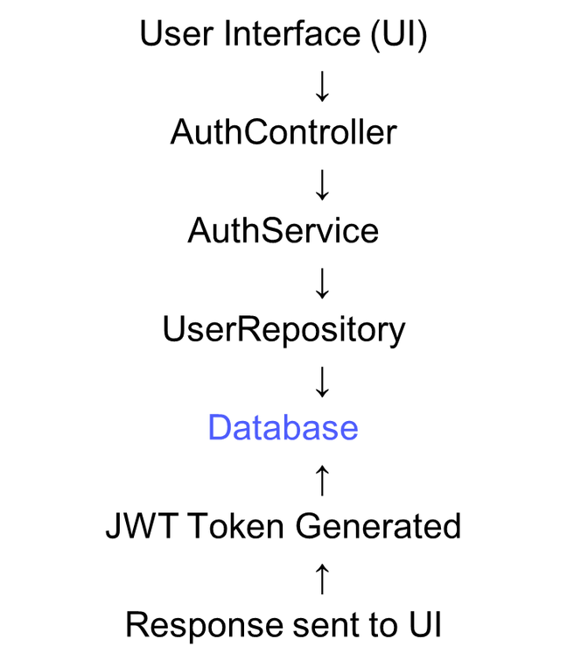
MODULE 1 – SUMMARY & STRENGTHS
FLOW
Key Strengths
•Secure authentication
•Encrypted password storage
•Token-based authorization
•Industry-standard architecture

Slide 11

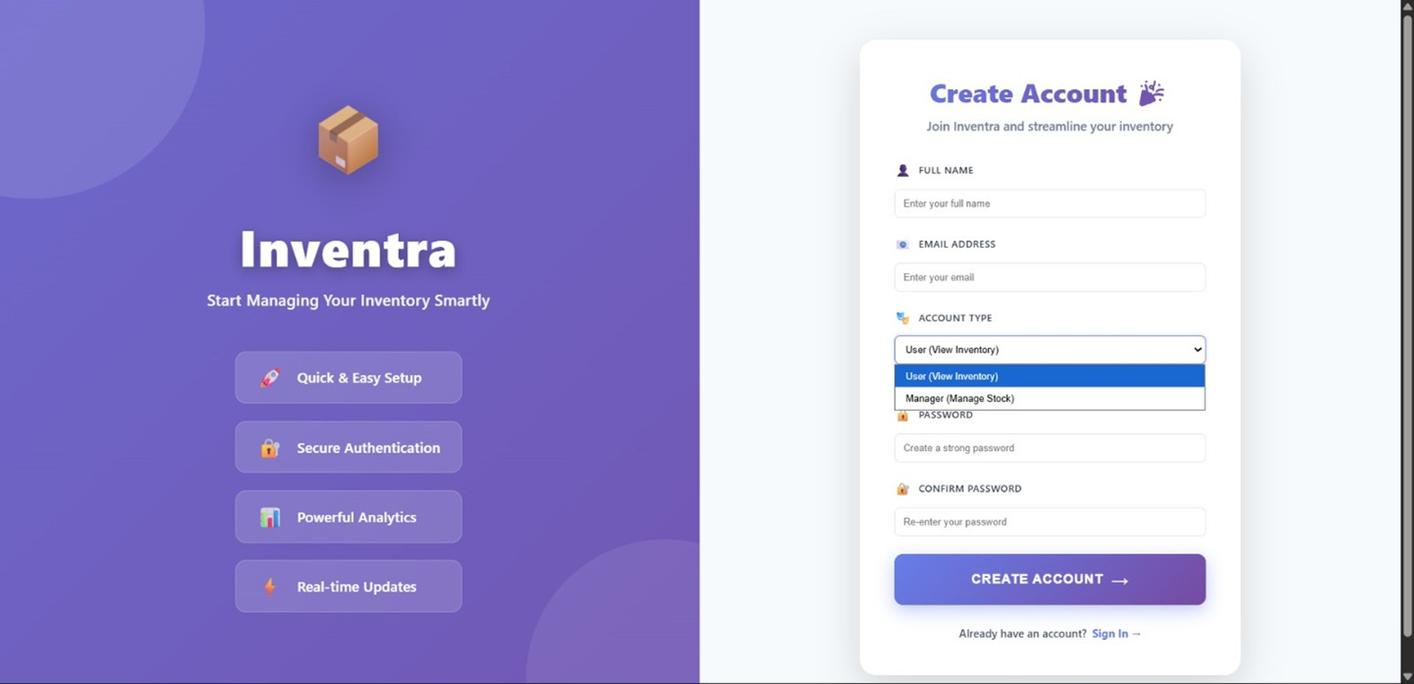

Slide 12
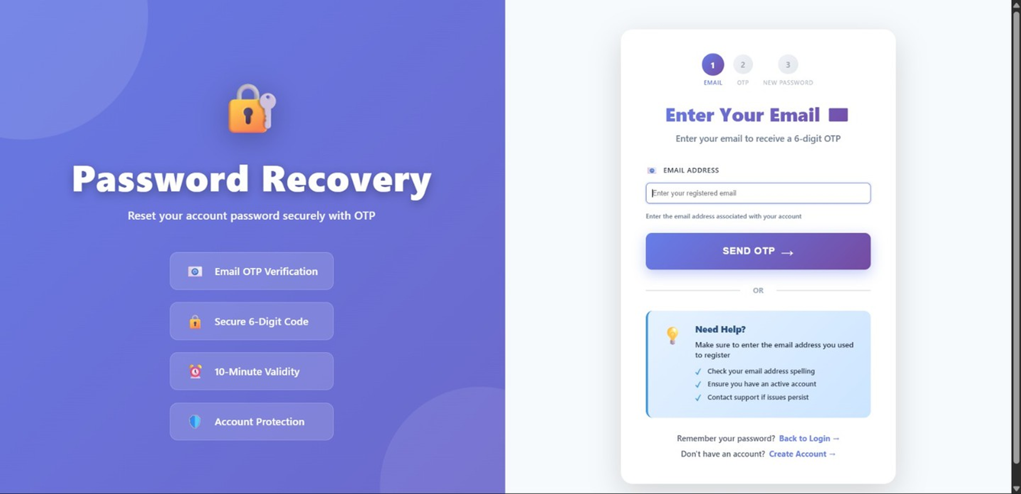

Slide 13
MODULE 2: PRODUCT / INVENTORY MANAGEMENT
Module 2 is the core operational module of the Inventra – Intelligent Inventory Management System.
It is responsible for managing products and maintaining accurate stock levels in real time.
Purpose of Module 2
•The main goal of this module is to:
•Store product details in a structured manner
•Track stock availability continuously
•Handle real-world inventory operations like stock-in and stock-out
•Prevent stock mismatch and negative inventory

Slide 14
MODULE 2 – KEY CLASSES
Product Entity - Product data model with SKU, quantity, price
ProductController - REST endpoints for product operations
ProductService - Business logic for inventory management
ProductRepository - Database queries
TransactionService - Logs stock movements

Slide 15
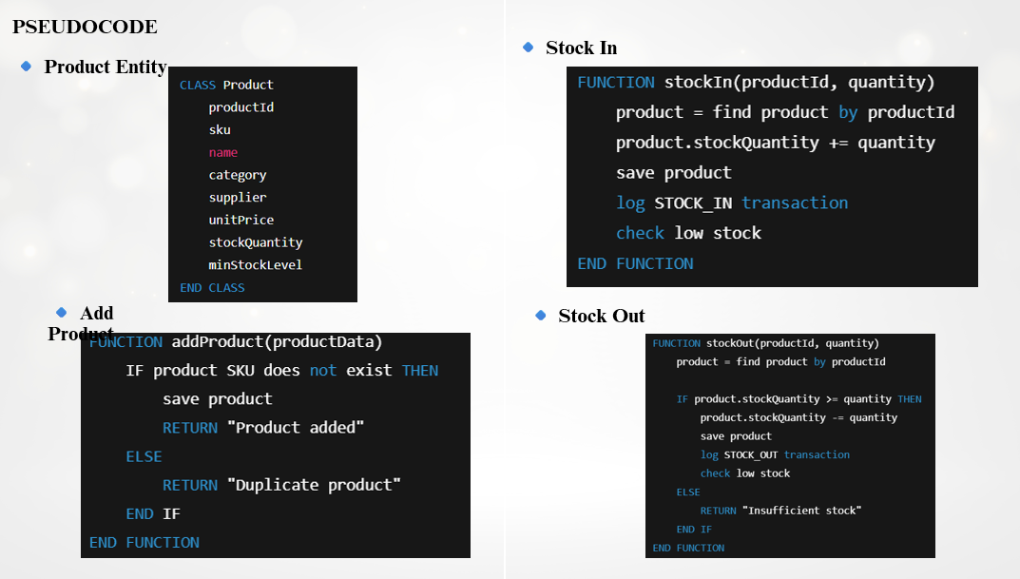

Slide 16
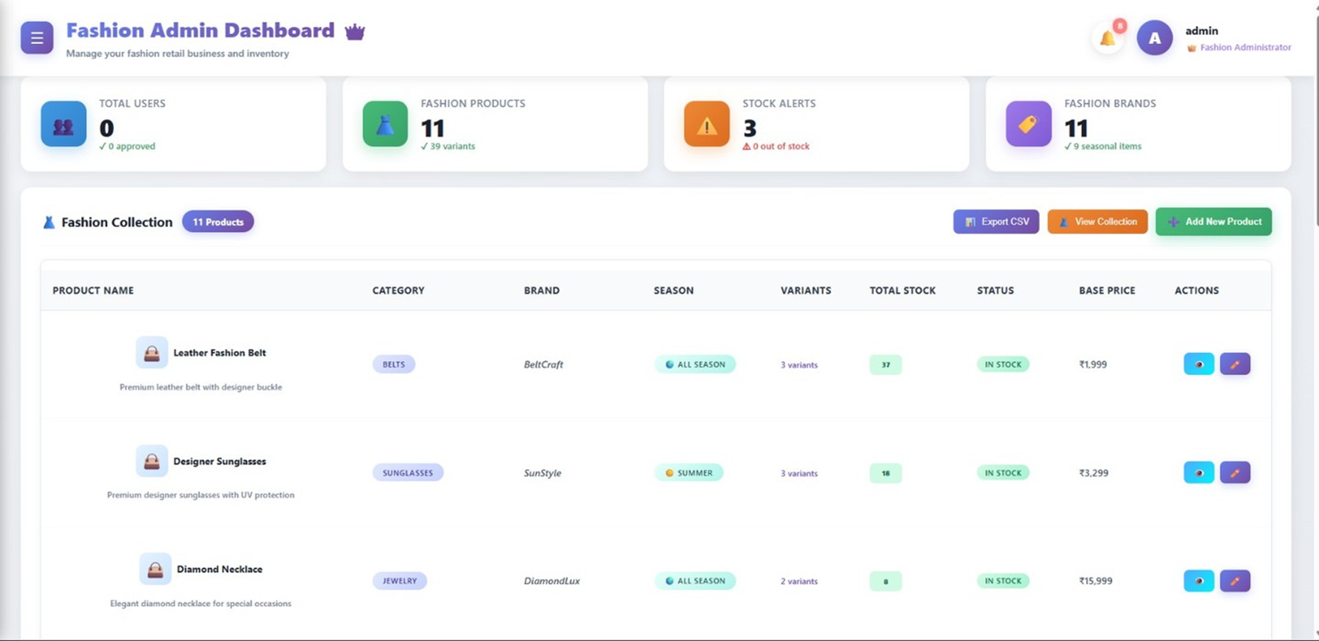

Slide 17
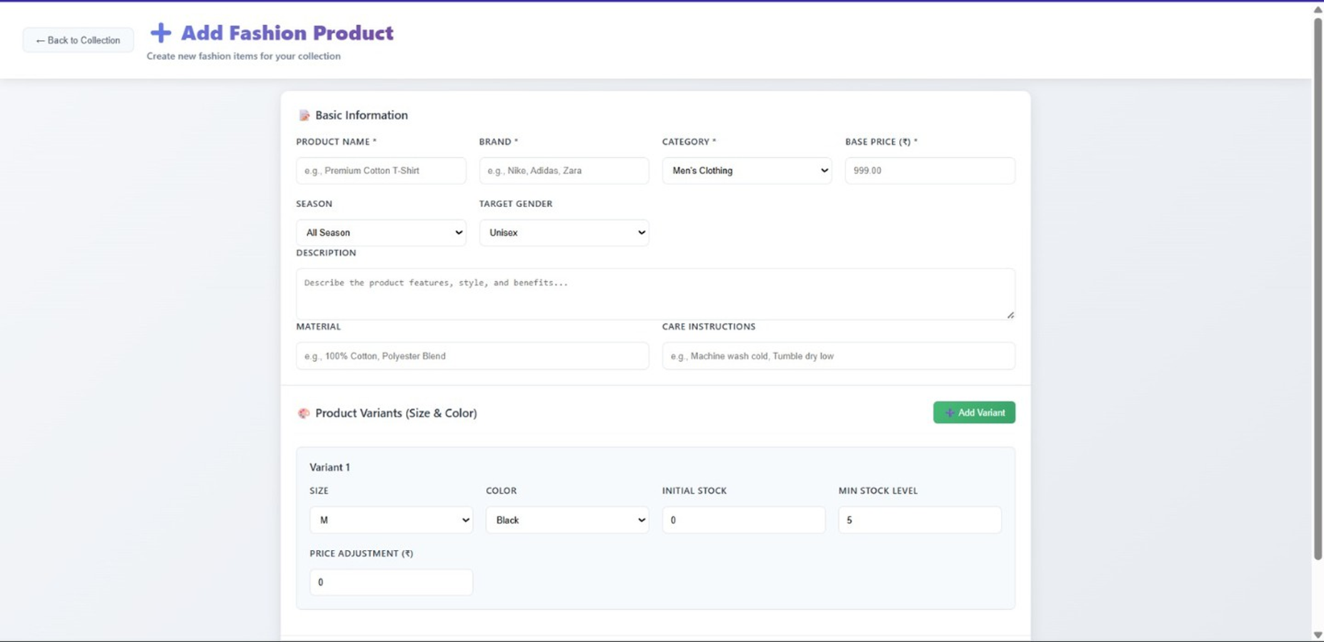

Slide 18
MODULE 3: INVENTORY ALERTS MODULE
Purpose of Module 3
The main objectives of this module are to:
Detect low-stock conditions in real time
Notify users at the right time
Avoid repeated or unnecessary alerts
Improve inventory decision-making
ALERT TRIGGER FLOW
Stock Update → Check Minimum Level → Alert Triggered

Slide 19
MODULE 3 – KEY CLASSES
Transaction – stores issue/return record
IssueService – handles issuing items + stock reduction
ReturnService – handles return + stock update
TransactionHistory – view/search/filter transactions
TransactionRepository – DB insert/fetch transactions

Slide 20
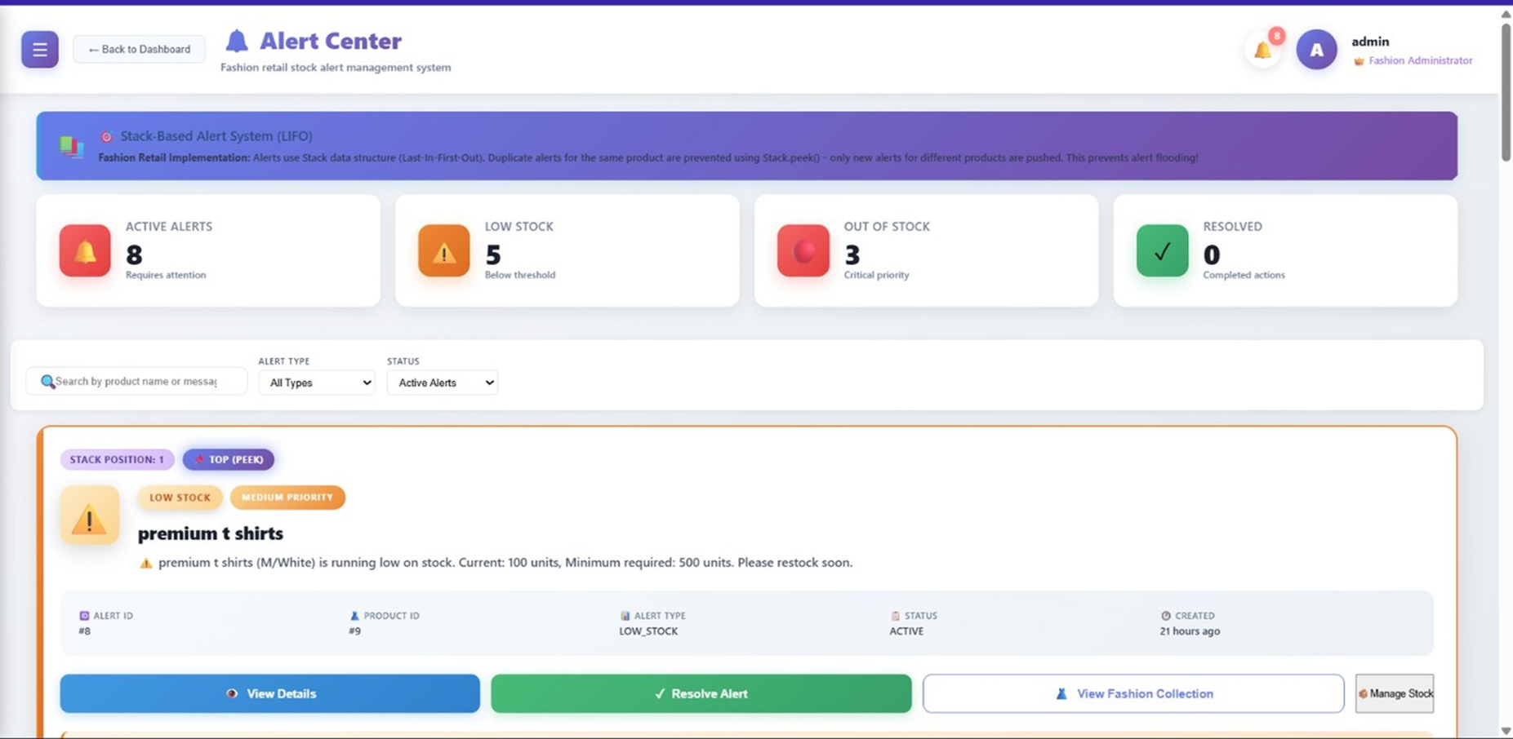

Slide 21
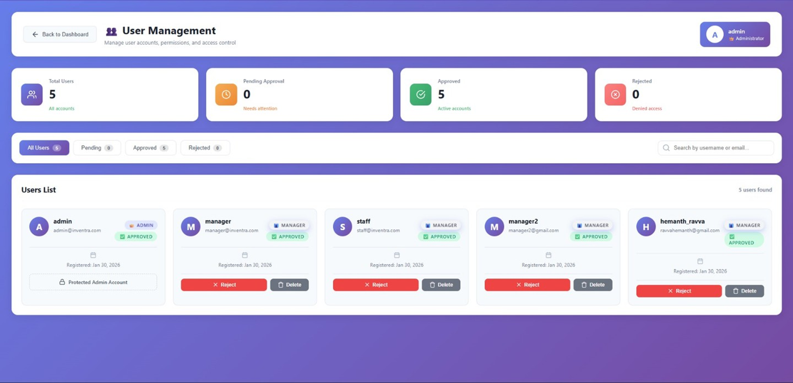

Slide 22
MODULE 4: REPORTS & ANALYTICS
Module 4 is the Reports & Analytics part of Inventra.
It converts inventory + transaction data into useful insights.
It shows the dashboard view with charts and summary counts.
Helps admins/managers monitor stock and decisions easily.
To generate real-time reports from system data
To display:
Total items
Available stock
Low stock alerts
Recently issued/returned items

Slide 23
CONCLUSION
Inventra transforms inventory management from manual
tracking to intelligent monitoring, helping businesses:
Increase efficiency
Reduce losses
Make faster decisions

